Slide 1
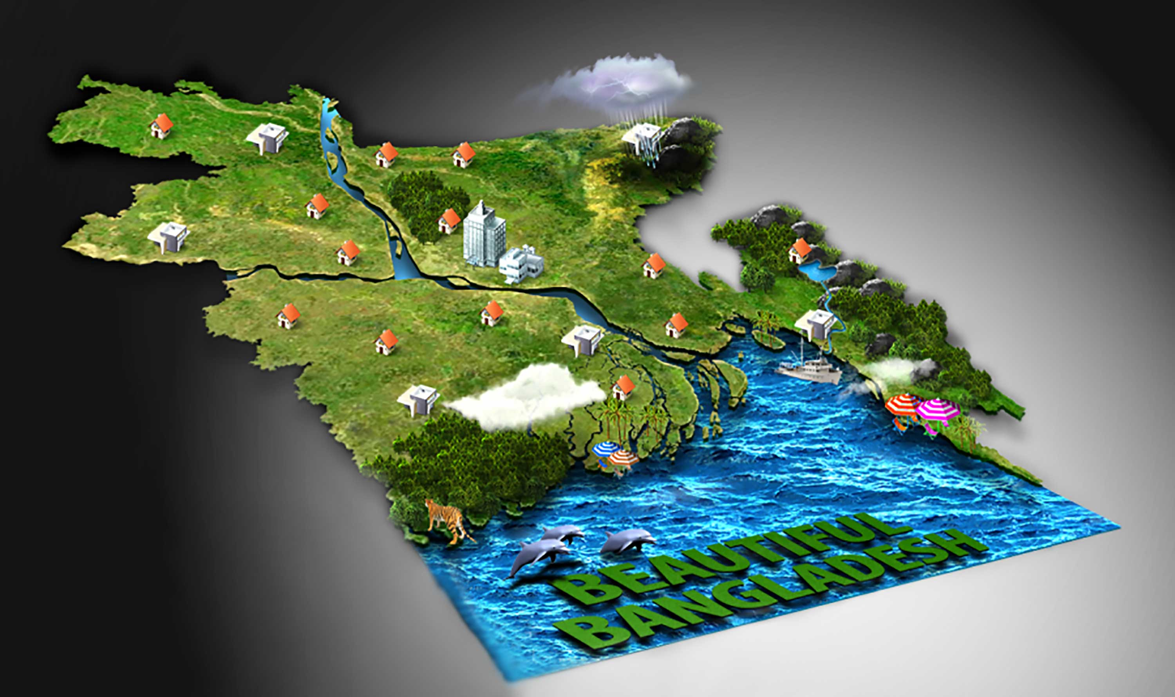
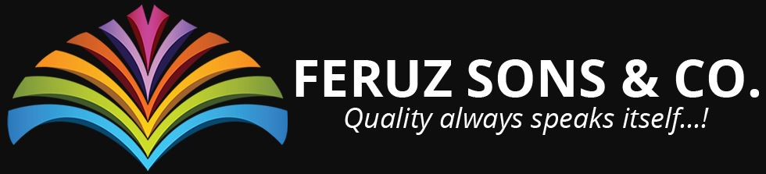

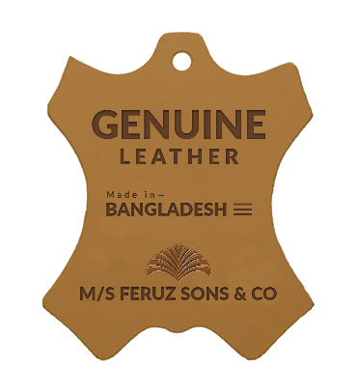
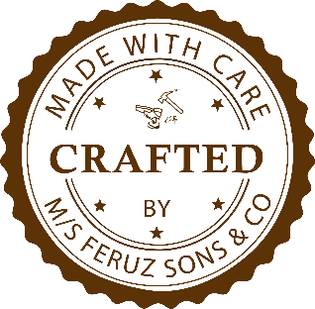

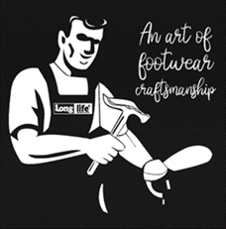





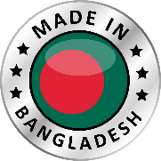


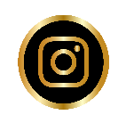


“We Customize
For Your Brand
& Private Label”
by OEM/ODM/OBM based production service.
With A Huge Possibility Of Quality Leather Footwear Manufacture And Export To Worldwide From Bangladesh.
100% Export Oriented OEM/ODM/OBM based Shoemaker…
We customize & Develop Shoes as your need...
We Are Here For your Brand & private label...
We care quality each one pair of your Brand shoes
A finest quality & rich crafting platform for your Brand...
We produce for all Gender according to your requirements..
www.feruzsons.com
100% EXPORT ORIENTED OEM/ODM/OBM BASED SHOEMAKER…
Since Year Of 1995. Production With Highly Skilled Shoemakers, Advance Machineries & Up-to-date Global Practices. We Believe In Tailored Services. Be It Established Or Emerging Businesses. Communications And Execution Are Streamlined Without Time Zone Limitations And Language Constraints.

Slide 2
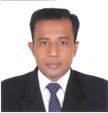

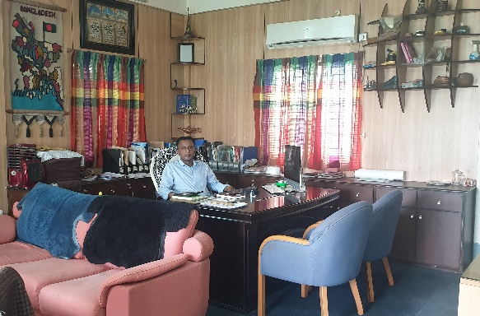




SCHOLASTIC RECORDS:
RÉSUMÉ
MD.
REZAUL KARIM
2007 MBA, Obtained from Nakano Business Collage, Tokyo, Japan
2003 Japanese Language Study, Obtained from HJLS, Tokyo, Japan
1995 BA, Obtained 1st from Comilla Ajjit Guha College, Bangladesh
1993 HSC, Obtained 1st from Comilla Ajjit Guha College, Bangladesh
1991 SSC, Obtained 2nd class from Comilla high School, Bangladesh
MANAGING DIRECTOR
BIO
WORK EXPERIENCE AND PERSONAL SKILLS:
I am energetic, flexible, adaptable & truly kind young self-made man. I am capable to do hard work efficiently, able to generate innovative ideas, also a constructive and diplomatic team player with strong communication skills, have hug knowledge and interest on latest technology,
Worked (as trainee) in Taito footwear company ltd. Japan for two years. (2004-2006)
Founder & Managing Director in M/S Feruz Sons & Co. Bangladesh. Since-2007 (13 Years in shoes manufacturing.)
Founder of M/S Feruz Sons & Co. Bangladesh. Since-1995 (Wooden Furniture manufacturing & retailers.)
Written and Oral fluency, both in Bengali, English, Japanese. (Hindi, Urdu - Oral fluency only)
(I was live in Japan 5 years for my study purpose, that is why I can write & read Japanese very well, and I know well about their business views.)
Able to generate innovative ideas. Capable of hard working efficiently. Constructive and diplomatic team player with strong communication skills. Flexible, adaptable and able to learn quickly.
15 years experienced in management and factory operation.
Sales & marketing. Business planning & implementation.
About Me
Date of Birth: September 15, 1976
Religion: Islam
Nationality: Bangladeshi
Sex: Male
Marital Status: Married
Social Responsibilities
Contact Me
I has been established an elementary school for Orphaned children in my own village where I born, and I expand a major percentage of my business profit for developing their education & lifestyle since my business life. I believes that the educated young generation only can make a change our social environment & economy of Bangladesh. Now in this school have total 112 Orphaned students with 10 of teacher & stuffs.
Cell Phone: +880-1713-312299
Land Phone: +880-81-64881
Email: info@feruzsons.com
Web: www.feruzsons.com

Slide 3
A Brief Profile of:
M/S. FERUZ SONS & CO.
COMPANY PROFILE:
Feruz Sons & Co. is one of well reputed footwear crafting platform in Bangladesh. We offer Buyer’s Brand & Private Label development, Design & Product development, Production, Sourcing & Solutions for highest-quality leather footwear made by extremely skilled & experienced shoemakers for buyer’s Brand product, Importer, Distributors, Traders, Designers, Chain shops, and Retailers worldwide. Who are looking for high quality footwear for their Brand or private label. and who are also believe in the handmade philosophy, embracing celebrated qualities that come with original craftsmanship.
FSC was born in the East zone of Bangladesh. In the field of footwear sector, we started our journey since year of 1995, but export we started on 2007. Now we are 100% export-oriented leather footwear industry with linkage of reputed suppliers of all kind of raw-materials. We exporting all kinds of leather footwear on ODM/OEM/OBM basis as per buyers designs and specifications, ruled by the rich quality & finest craftsmanship, those are our biggest strength to win our clients’ heart. Feruz Sons produce men/women/children’s leather footwear according to client’s requirements from anywhere around the globe.
Feruz sons has already been introduced in Japan, UK, USA & few of European countries. Our footwear & our leather products are already proved his quality and standard in the world market by used the famous Bangladeshi Cow, Buffalo, Goat, Sheep leather.
By building trusting, honest and sincere relationships with our clients, employees, and partners, we hope to cultivate a stimulating environment resulting in future opportunities for Bangladesh.
REGISTERED OFFICE ADDRESS | : | Gungchor, Thana Road, Comilla-3500, Bangladesh. Phone No: 081-64881, Mobil No: 88- 01973666601
FACTORY ADDRESS | : | Alekharchor, Beside National Highway, Durgapur, Comilla-3500, Bangladesh. Phone No: 081-61009, Mobil No: 88- 01973666611
YEAR OF ESTD | : | 1995 for local market (Export started on 2007) Footwear
LEGAL STATUS | : | Proprietorship Company (On process to be Ltd. Company)
CAPITAL IN USD | : | 03 Million USD Only (including all company assets)
ANNUAL TURNOVER | : | 04 Million USD
FACTORY AREA | : | Total 4500 Sq. Meter
EMPLOYEES | : | 250 people (including job worker)
MACHINERY | : | Made in Italy, Korea, China, Taiwan
PRODUCTION & CAPACITY | : | (Leather Moccasin / Shoes / Boots -600-700 Pairs.) (Leather Sandal -800-1000 pairs) = Daily (08 Hrs./Shift)
TYPE OF PRODUCT | : | Sandal, Shoe, Boots, Moccasin , Jute Espadrilles’
MAIN MARKETS | : | JAPAN, USA, UK, EU
GENDER |  | Men’s - Ladies - Kid’s

Slide 4
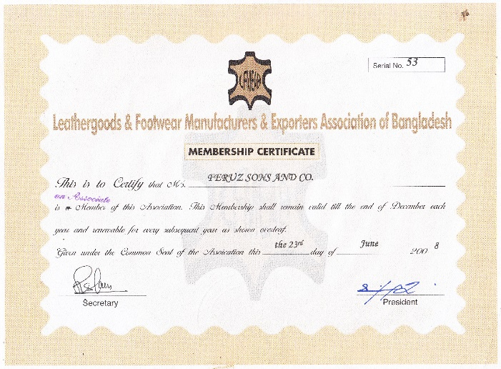
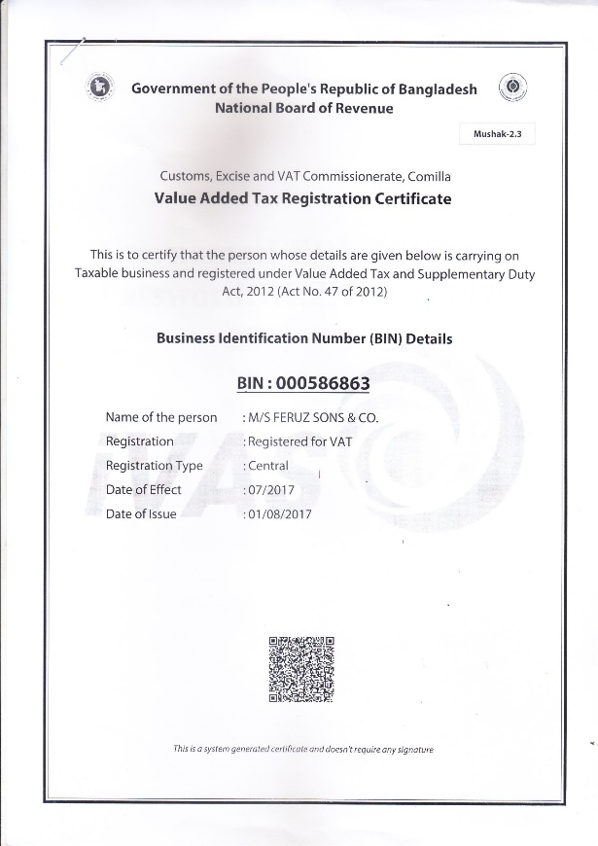
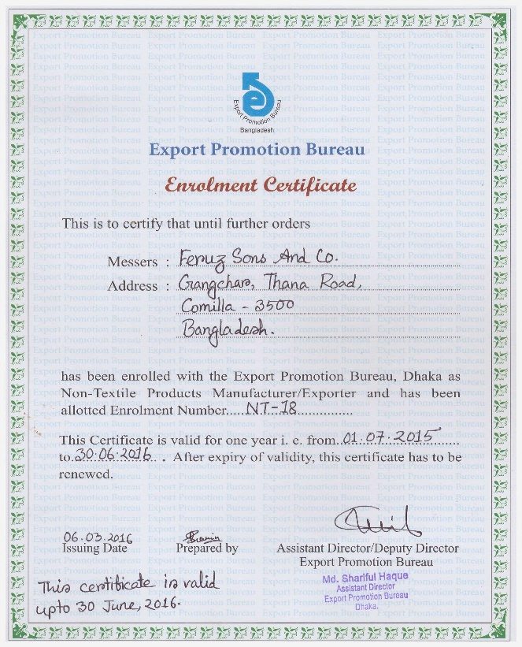
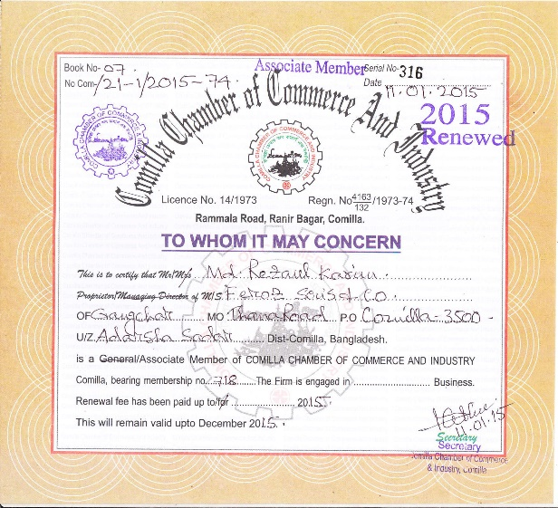

OUR CERTIFICATES
LFMEAB-
(Member Certificate)
VAT CERTIFICATE
EXPORT PROMOTION BUREAU- (MEMBER CERTIFICATE)
Comilla Chamber of Commerce And Industry-
(Member Certificate)

Slide 5
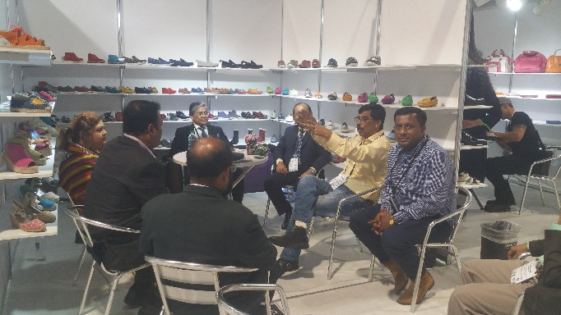
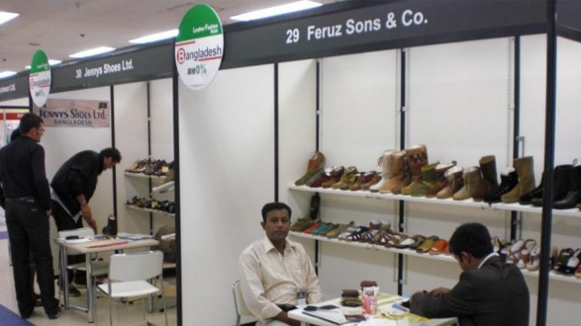
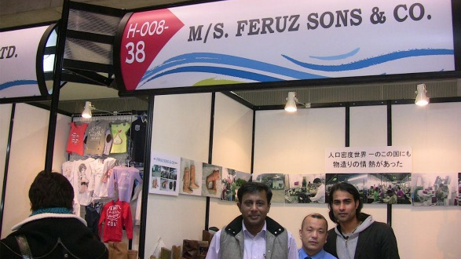
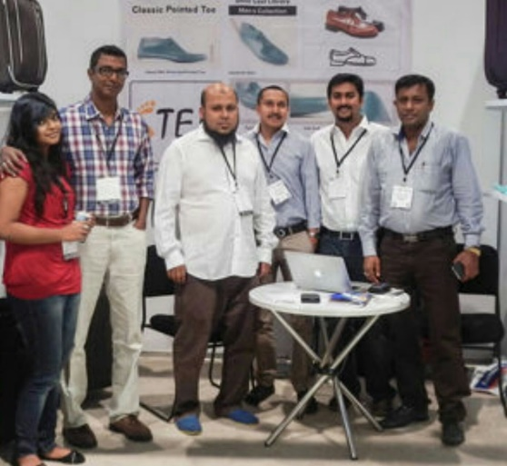
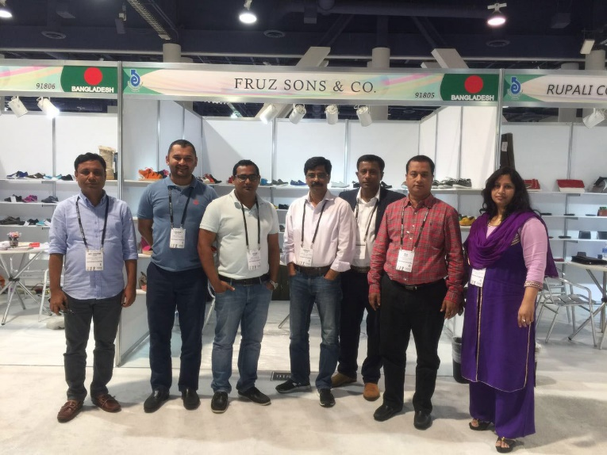
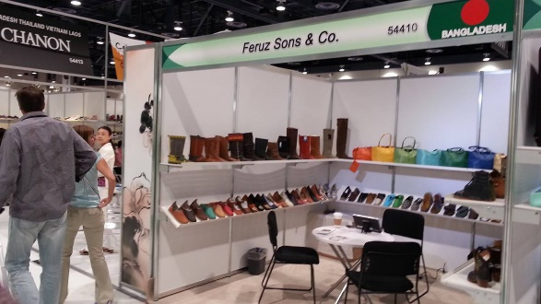
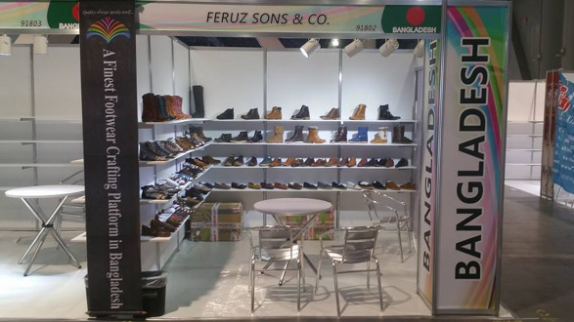
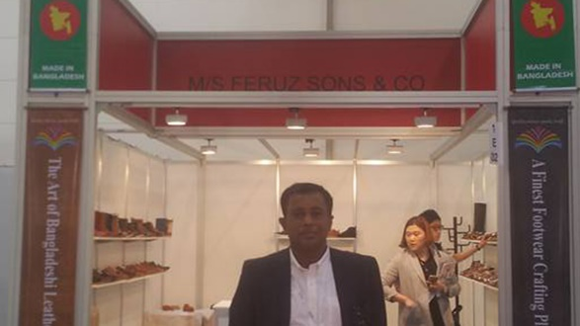
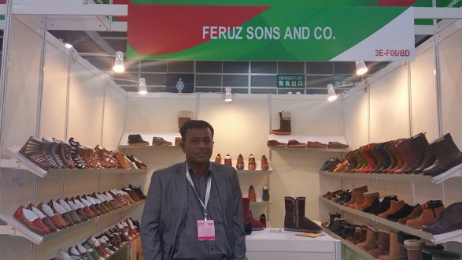
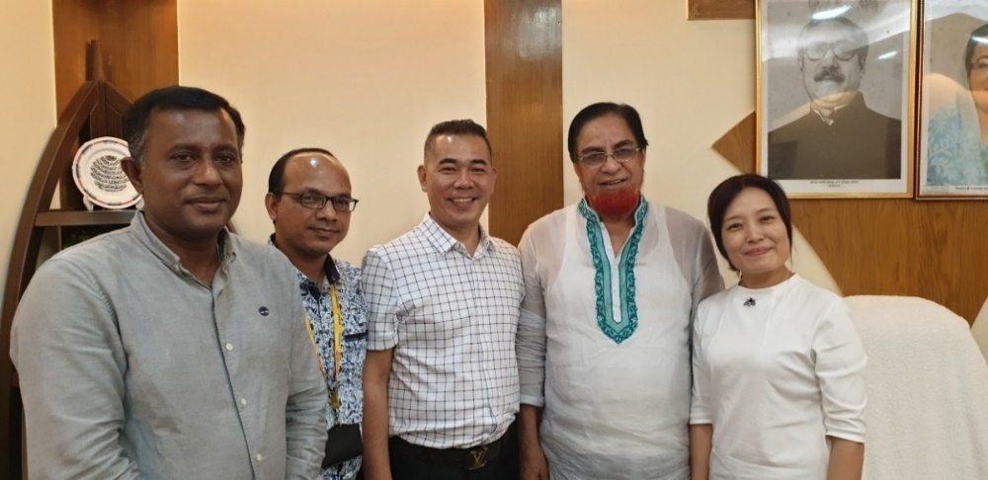
International Trade Fairs We Attended
Int. Shoe Fair, Japan 2009
Int. Fashion Fair, Japan 2011
Magic Show, USA 2013
Magic Show, USA 2016
GDS Fair Germany 2016
Hong Kong Fair 2016

Slide 6
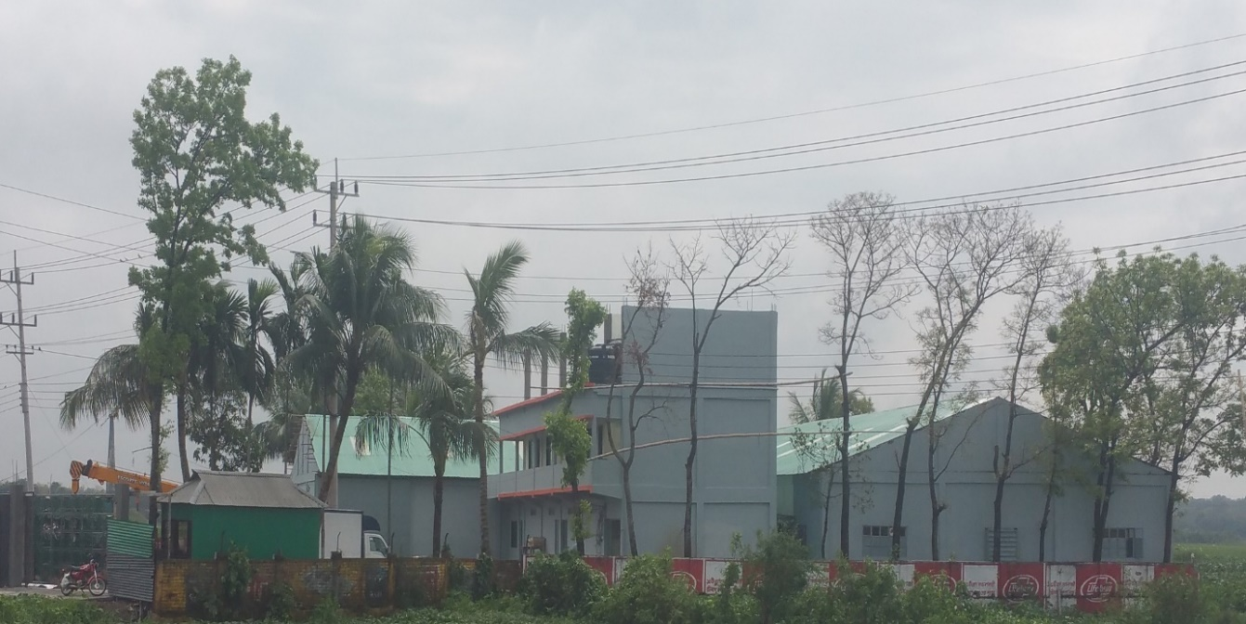
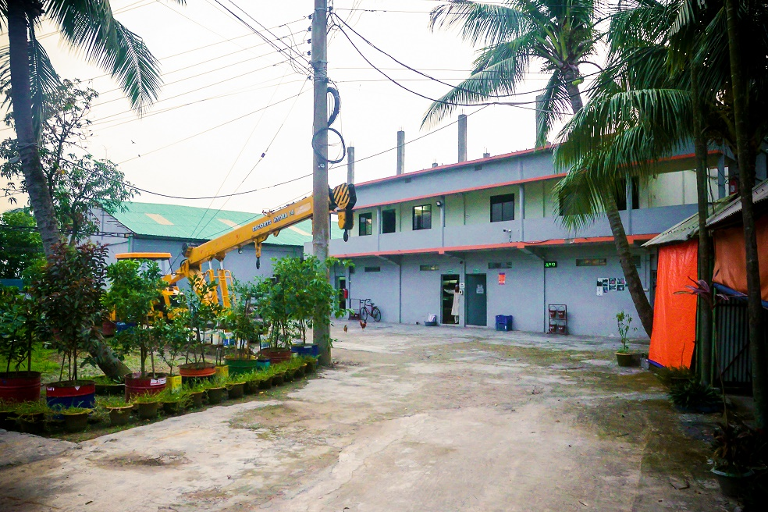
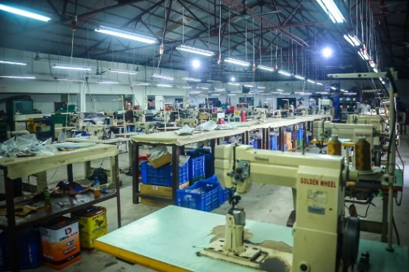
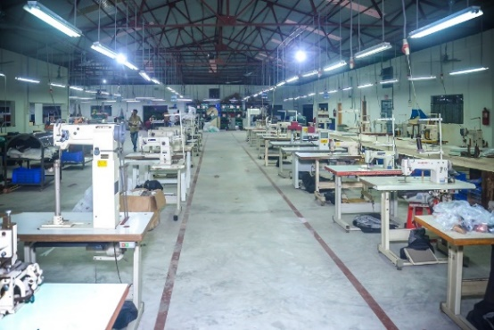
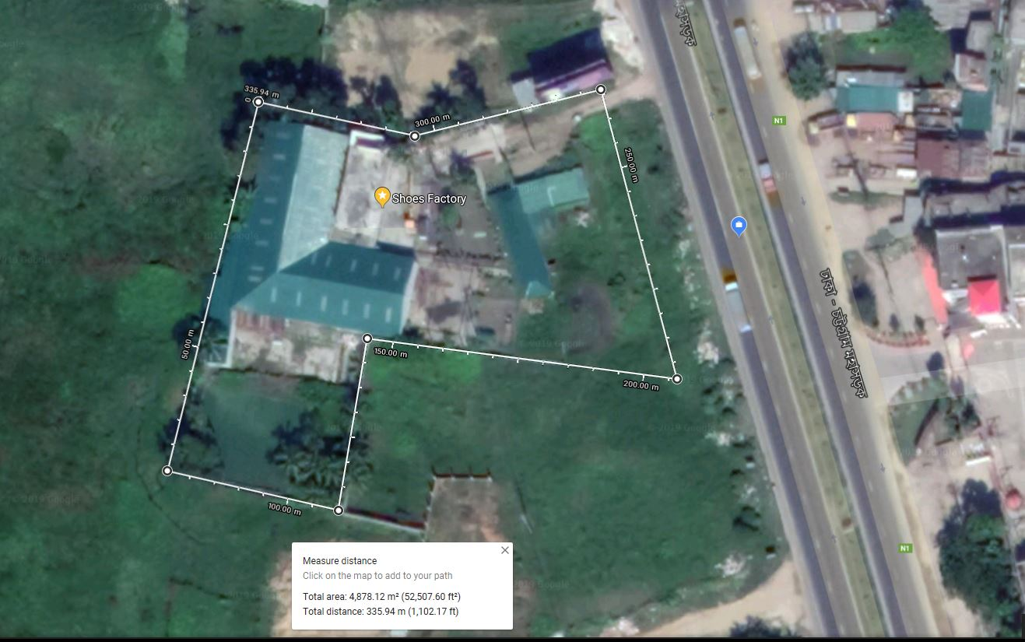
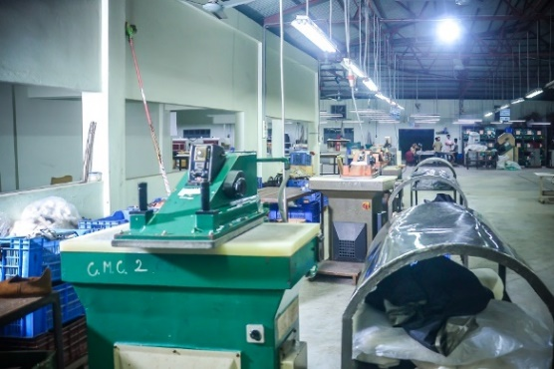
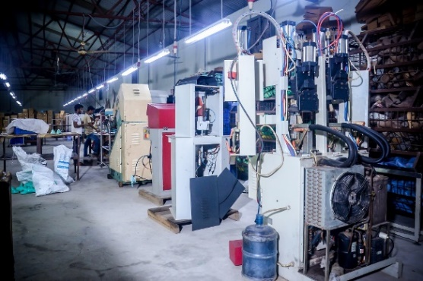
Our Factory Pictures
Factory Side View
Factory Inside View
Factory View on Google Map

Slide 7

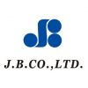
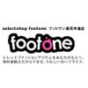
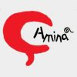


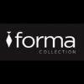
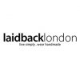
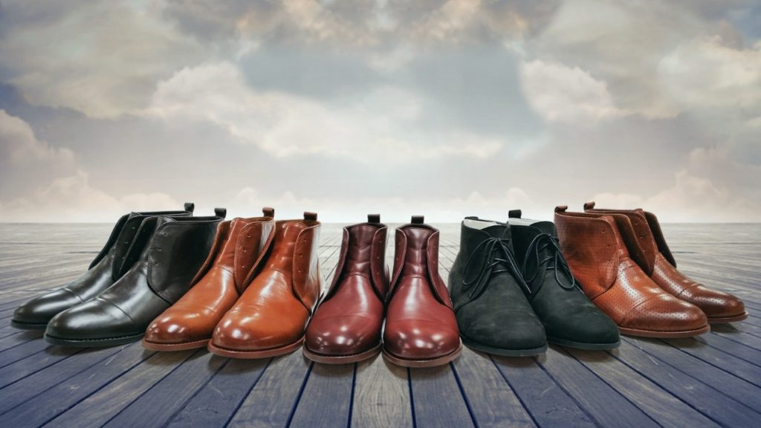
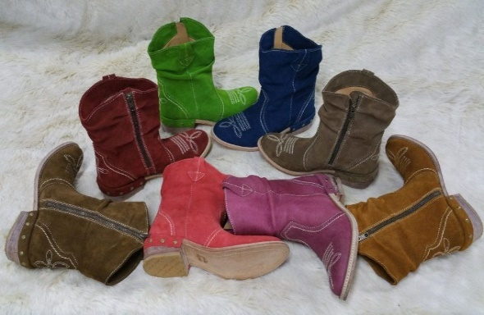
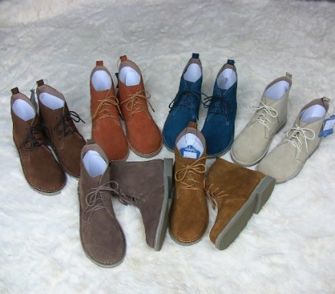
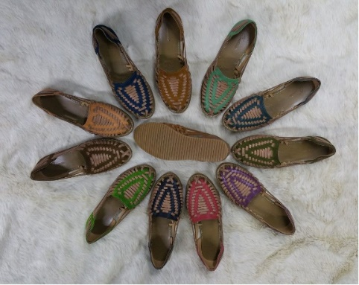
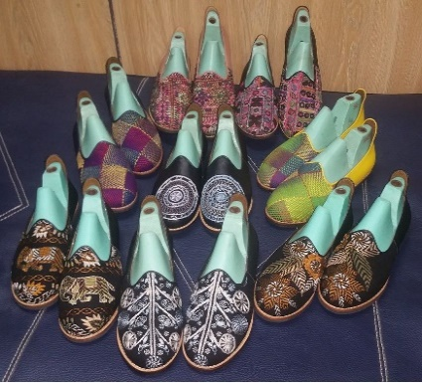
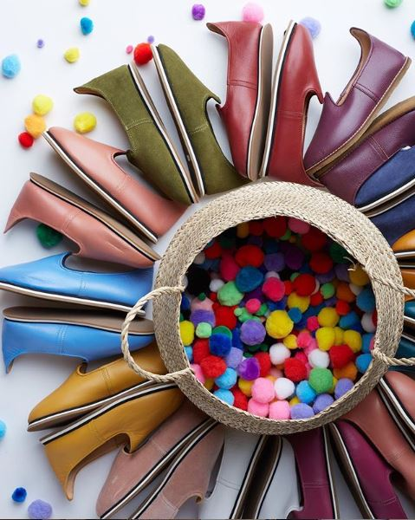
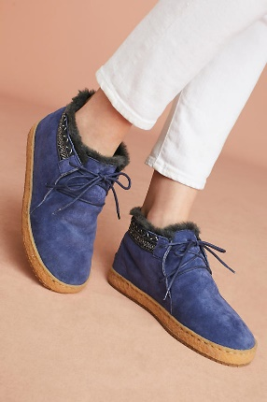
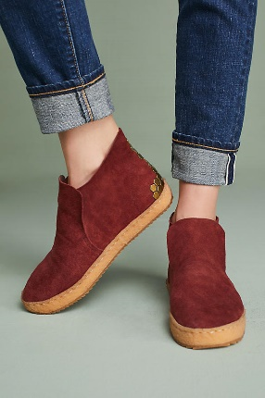
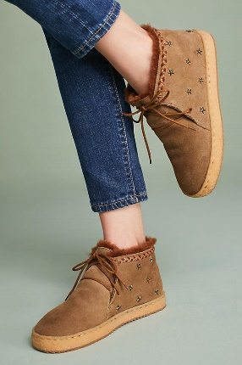
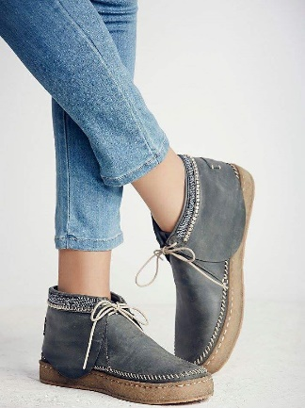
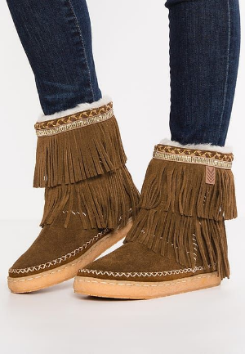
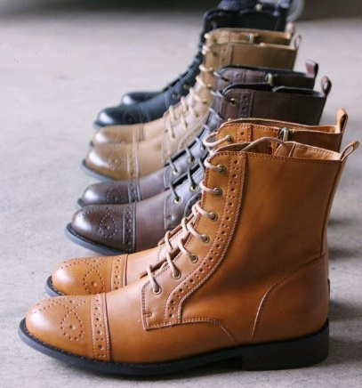
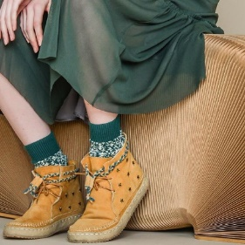
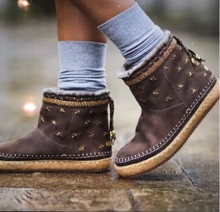
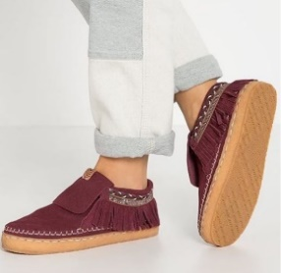








OUR PRODUCTS

Slide 8
Bangladesh & Facilities
Business Possibilities
WHY BANGLADESH?
BUSINESS POSSIBILITIES
As Bangladesh is a fast-growing country, And Bangladesh is now 2nd largest manufacturer & exporter in world RMG market by readymade garments manufacturing and export volume. By the same way footwear industry also growing very faster. Bangladesh is one of best footwear buyer's target country for leather shoes & leather goods manufacturing facility. Now a day all buyers are looking to move from China for increased labor wages, product cost & as political strategy, and Bangladesh is best choice of them for low-cost labors, low-cost utility, Government support, Duty free access worldwide, And here have lots of high-quality leather from own inland sourcing- Cow, Buffalo, Goat leather, that is another reason to expanding leather footwear industry here day by day.
And most important benefit for Bangladesh made product is Duty free access to all European country including Australia, Japan, S. Korea, UK, Russia, China, Canada. because of REX & GSP facility (Generalized System of Preferences) FORM"A" Which is enabling for importer to pay reduced 100% import duties from buyer’s home custom to enter Bangladesh made product with duty free facility in their market. that is the main reason buyers are actively looking for a good factory in Bangladesh.
The Bangladeshi shoe industry is in high demand from worldwide last few years. And world’s almost all big brands are making theirs brand shoes in Bangladeshi factory, and lot of Italian, Japanese, China, Taiwanese are re-located/moved their production unit/factory or started their production here in Bangladesh in their own factory, either-or in a Bangladeshi factory. And as per present world political strategy, lots of countries are planning to move investment & factories out of China, and Bangladesh is one of them to choose.
Now we are 15 years experienced company, we have huge knowledge in footwear manufacturing processes, with linkage reputed suppliers of all kind of raw-matareals & others related accessories. It has been inherited expertise and foreign know-how; our skilled craftsmanship has given a new face to our company.
In Bangladesh now have, High quality & well-equipped leather tanneries, all kind of sole & socks factory, Last factory, Mould Factory, zipper factory, packaging factory and all metallic & nonmetallic accessories factory.
Our city Comilla is one of shoe city, here have 12 big & old reputed factory. Also have an EPZ (Export Processing Zone) here have lots of foreign owner industries. That for live in comilla as a foreign person have all relevant facility here. In this Comilla’ s shoe factory making world's best Brand shoes. such as: Caterpillar, Wolverine, Bates and Dr. Marten, JCPenney, Timberland, Nike, DSW, Damart, EL Corte ingles, AUCHAN , etc..
Dhaka is our capital city very close to our Comilla city. (only 100km from Dhaka by new developed 4-lane National Hi-way) Comilla is in middle place in-between Dhaka & Chittagong city. Chittagong is one of our main largest Sea port City & Also Business capital city.
Our inspiration are our clients and peoples that appreciates for this footwear workmanship, rich crafting & finest quality, we have in mind to keep quality of each one pair of your shoes, as we know its directly involved with your Brand reputation. Built upon this foundation, FSC gathered a collective of talents, specialized in the departments of design, sourcing, production management, and manufacturing to deliver the best traits of Bangladeshi shoemaking to the global market.

Slide 9
Generalized System of Preferences (GSP) or REX
Duty Free Market Access Facilities For Bangladeshi Exportable Products for world-wide
Bangladesh as a least developed country (LDC) is enjoying duty free market access or reduced tariff rate facilities to export to various developed and developing countries in the world. this facility is enhanced and privileged by the membership of world trade organization (WTO). besides, Bangladesh is the member of different regional trade blocs. thus the country enjoys duty free or reduced tariff rate access to other member countries.
WTO members always recognize the necessity of providing duty free quota free (DFQF) market access to LDCS. it was decided in the 6th WTO ministerial conference held in Hong Kong in 2005. all developed countries will provide DFQF market access to LDCS for at least 97% tariff lines. Bangladesh is getting DFQF market access to different markets. this is the first legally binding decision on DFQF for LDCS.
Bangladesh is getting GSP facilities from 39 countries:
EU Countries | New EU Countries | Countries excluding EU
1. France | 1. Cyprus | 1. Canada
2. Finland | 2. Czech Republic | 2. Turkey
3. Germany | 3. Estonia | 3. Japan
4. Ireland | 4. Republic of Poland | 4. Russia
5. Luxemburg | 5. Slovenia | 5. Norway
6. Denmark | 6. Slovakia/Slovak Republic | 6. Switzerland
7. Greece | 7. Hungary | 7. Republic Belarus
8. Netherlands | 8. Lithuania | 8. Liechtenstein
9. Portugal | 9. Latvia | 9. New Zealand
10. United Kingdom | 10. Malta | 10. Australia
11. Austria | 11. Rumania | 11. Iceland
12. Spain | 12. Bulgaria
13. Belgium | 13. Croatia
14. Italy
15. Sweden
South Korea is giving us duty free market access on 4,802 products under “Preferential Tariff for Least-Developed Countries”;
China is giving us duty free market access on 4,788 products under “Duty Free Treatment Granted by China”;
India is giving us duty free market access on all products under SAFTA (except Tobacco & Drugs);
Other SAARC countries are giving us duty free market access on some products under SAFTA/SAPTA;
Thailand is giving us duty free market access on 299 products under BIMSTEC
Malaysia is giving us duty free market access on 525 products;
Chile will give us duty free market access on all Bangladeshi products from 1st January 2015.

Slide 10
Terms & Conditions for import our product
If you have an Origin sample & like to make as like your origin:
a) Origin sample. b) Details Instructions sheet if need any change & modification.
If you have only graphics design file: a) Design sheet with Details instruction. b) Shape & Size sample. c) Upper, Lining, Insole Leather swatch, Fabrics, or other’s materials swatch. d) Out sole design or type of sample. e) Metallic Buckles or other’s accessory sample or swatches.
SAMPLE COST: We provide sample free of cost (It’s depended on design & quantity) but courier cost will be on buyer's account. Usually, we charge 100US$ for per design sample. And if your samples out sole will be a molded sole, then you should provide us out sole mold or mold making cost for first time develop your sample.
PLACE AN ORDER: You may ask us for our designs. We will provide you what we have. And if you provide us your design then we will make & send you our factory sample for your approval, with prices and production time details. After receiving product sample or other information you may place an order with the following details:...
Purchase Order with- An order no, Product code, Product wise quantity/unit price/total price, Shipment date, Mode of Shipment (Air/Sea), Port of Destination, Details address where you want to receive the goods.
DOCUMENTS: All related and necessary documents with GSP (Form A)
PRICE & SHIPMENT: We have always exported with FOB price. And accept CNF & CIF price as buyer’s requirements.
FREIGHT & INSURANCE: Freight and Insurance to be covered by the Importer, which varies from port to port.
ADVANCE: If advanced 50% of the ordered value then the documents are sent to the Importers directly, otherwise sent to the Bank for collection against bill of exchange.
Please find the following details information if you want to do business with us and give us any order
BENEFICIARY: M/S FERUZ SONS AND CO.
BANK DETAILS: SONALI BANK LTD. & BANK ASIA LTD.
PAYMENT: To be made by 100% confirmed irrevocable L/C at sight. Or T/T (50% Advance with order & 50% before shipment.)
CONDITION: After receiving an order plan or confirmation we will send you a Performa Invoice for your signature. We will also send you our Bank details.
ORDER QUANTITY: No MOQ (Price is effect for lower quantity). But for best lower price Each product MOQ is 1000 pairs per style. This quantity also depends on product category.
PRODUCT LEAD-TIME: Between 60 to 90 days for per shipment, on receipt of L/C or advance T/T. Also depending on volume of order and depends on product category and time of year.
PORT OF DISPATCH: By Air: Dhaka International Airport, By Sea: Chittagong Seaport. Chittagong.
PACKING: Packing depends on product category, but we can pack according to buyer specifications provided the packing materials use locally available. If there are any special packaging/ packing requirements, buyer must specify this before order pricing.
DESIGN: Original Equipment Manufacturer (OEM) we receive designs and instruction from clients for develop, by use their own logo as brand product. Note: We can provide you design only for some of Bangladeshi traditional all leather sandals. Or those we develop for Trade fair showcase.
SAMPLES DEVELOP: For develop your new design as your own brand product by use your require Logo or as your specifications, you should provide us as following details:
Thanks to you to see our company details as well. Hope for build a new business relation with your company. If you have any question regarding the business, please mail us without any hesitate. Looking forward to hearing from you soon.

Slide 11






Its Nice to meet you…..Thanks for your time…
Company We Portal: www.feruzsons.com
Google Location Link: https://goo.gl/maps/3GGRu44JNsiJbCor7
Facebook Page: https://www.facebook.com/FeruzSons
LinkedIn: https://www.linkedin.com/company/feruz-sons-&-co/

